Slide 1


Session1:
Intro to STM32
CUERT

Slide 2

CAIRO UNIVERSITY ECO-RACING TEAM
Embedded Systems Concepts
Agenda
1
Programming concepts
2
STM32 Cube IDE
3
MORE MILES TO ACHIEVE
WWW.CU-ECO.ORG

Slide 3
Embedded Systems
CAIRO UNIVERSITY ECO-RACING TEAM
Embedded Systems Concepts
Embedded Systems
Microcontroller Architecture
MORE MILES TO ACHIEVE
WWW.CU-ECO.ORG

Slide 4
Embedded Systems
CAIRO UNIVERSITY ECO-RACING TEAM
Embedded Systems Concepts
MORE MILES TO ACHIEVE
WWW.CU-ECO.ORG

Slide 5
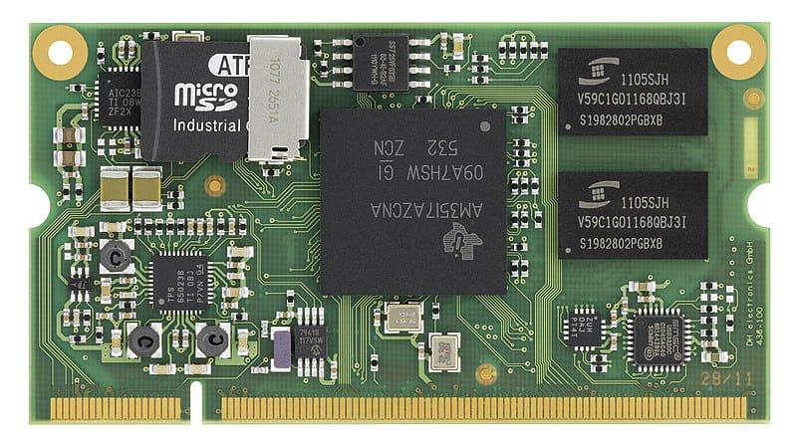
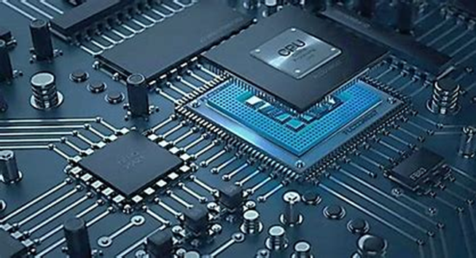
Embedded systems
CAIRO UNIVERSITY ECO-RACING TEAM
What’s an Embedded System
A combination of software and hardware
Performs a specific task as a part of larger system
MORE MILES TO ACHIEVE
WWW.CU-ECO.ORG

Slide 6


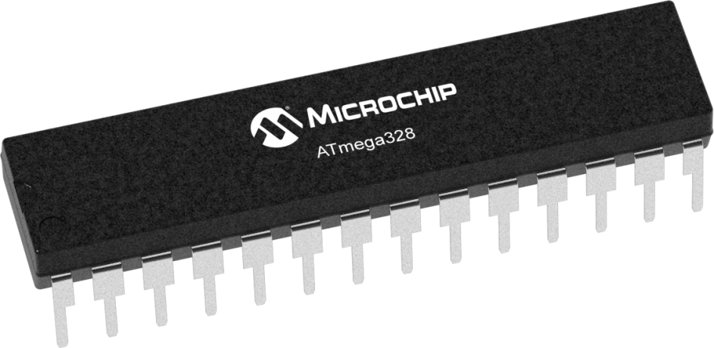

Embedded systems
CAIRO UNIVERSITY ECO-RACING TEAM
What’s an Embedded System
Embedded system is a system include software[Programing language] and hardware[Microcontroller]combination to Reach specific target.
Specific Target
Embedded System
MORE MILES TO ACHIEVE
WWW.CU-ECO.ORG

Slide 7
Embedded systems
CAIRO UNIVERSITY ECO-RACING TEAM
What’s an Embedded System
An embedded system is a specialized computing system designed to perform dedicated functions or tasks within a larger system. Unlike general-purpose computers, embedded systems are optimized for efficiency, reliability, and real-time performance.
Specific Target
Embedded System
MORE MILES TO ACHIEVE
WWW.CU-ECO.ORG

Slide 8
Embedded systems
CAIRO UNIVERSITY ECO-RACING TEAM
Embedded system and computing system
Embedded system | computing system
Specialized system designed for a specific task | System designed for multiple tasks and user interactions
Optimized for low power consumption | Higher power requirement
Ex: washing machines, ATMs , automotive ECUs | Ex : Laptops, desktops, smartphones
MORE MILES TO ACHIEVE
WWW.CU-ECO.ORG

Slide 9
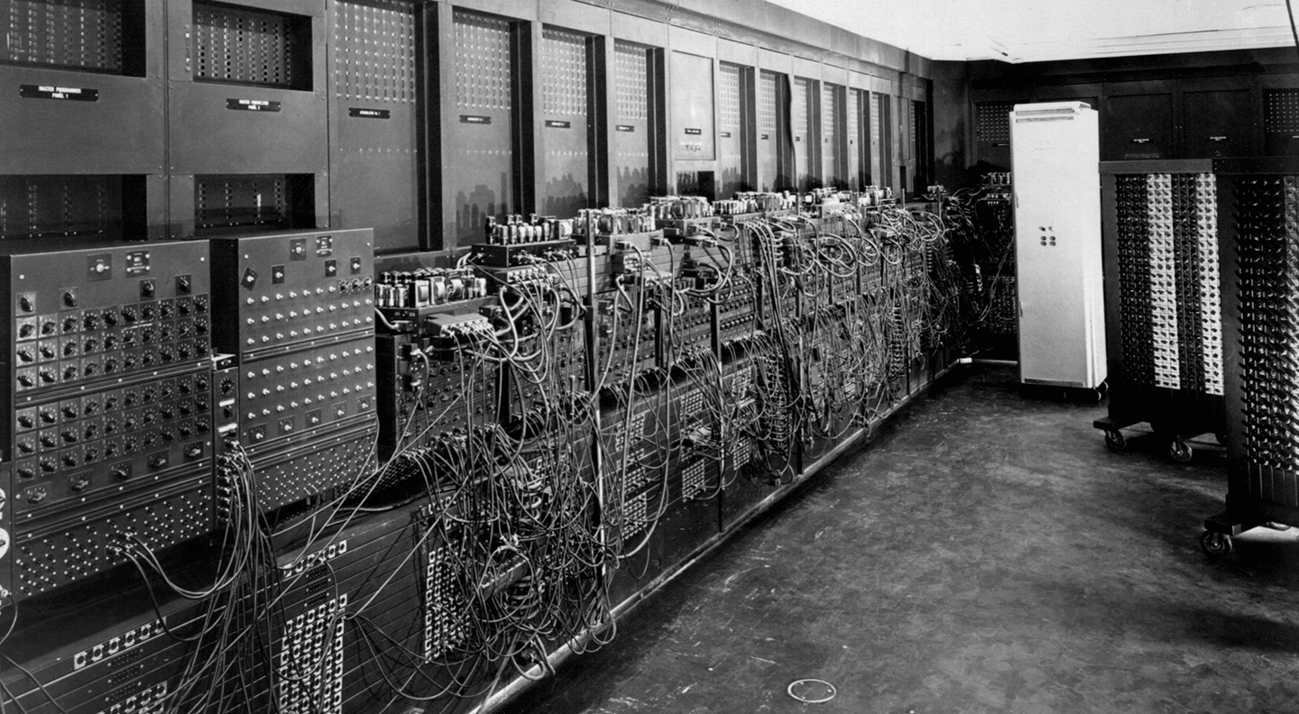
Embedded systems
CAIRO UNIVERSITY ECO-RACING TEAM
Historic PC
MORE MILES TO ACHIEVE
WWW.CU-ECO.ORG

Slide 10
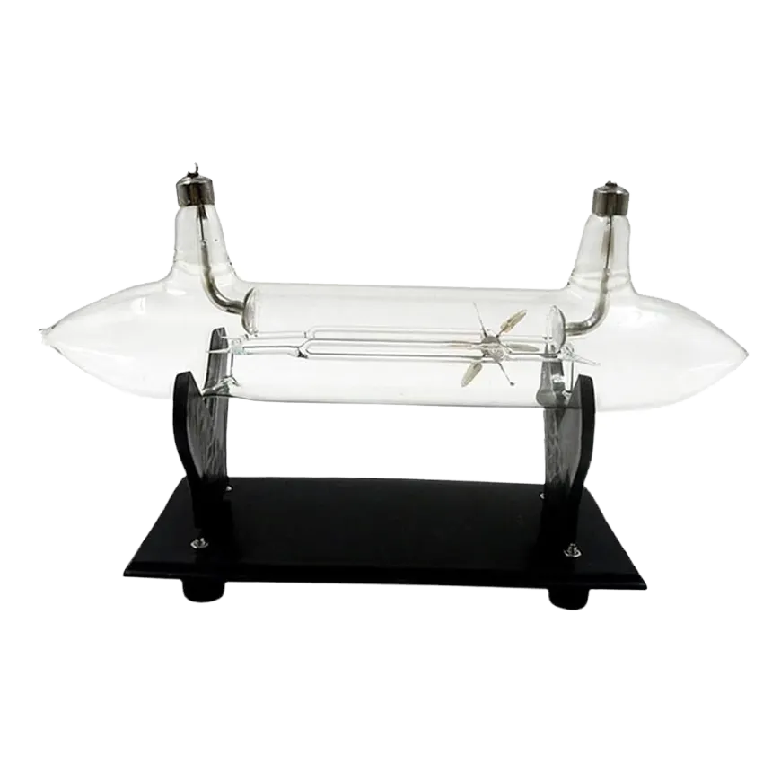
Embedded systems
CAIRO UNIVERSITY ECO-RACING TEAM
Cathode Tube
It were used before transistors and used a lot of energy and area
MORE MILES TO ACHIEVE
WWW.CU-ECO.ORG

Slide 11
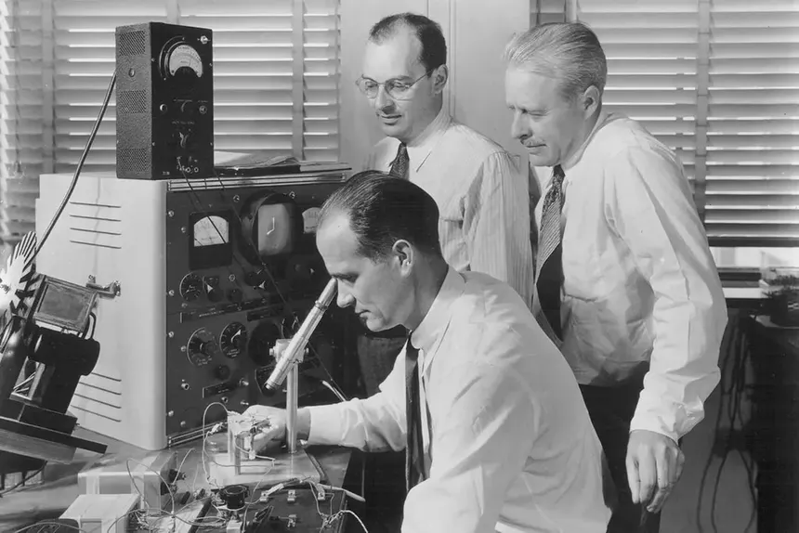
Embedded systems
CAIRO UNIVERSITY ECO-RACING TEAM
Historic Transistor
MORE MILES TO ACHIEVE
WWW.CU-ECO.ORG

Slide 12
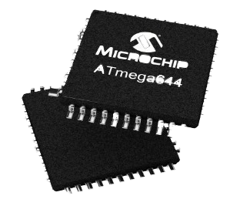
Embedded systems
CAIRO UNIVERSITY ECO-RACING TEAM
IC Chip
IC is Integrated Circuit is an assembly of electronic components like capacitors and resistors to perform a specific function like AND gate IC
Has different shapes but its function is known from the number printed on it and its data sheet not from its shape
MORE MILES TO ACHIEVE
WWW.CU-ECO.ORG

Slide 13
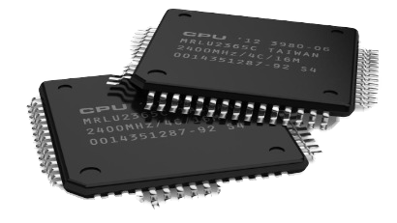
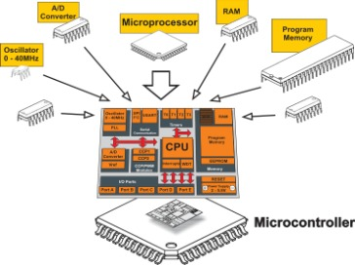
Embedded systems
CAIRO UNIVERSITY ECO-RACING TEAM
Microprocessor vs Microcontroller
It is the brain of the system
Consist of CPU only
It is a small computer on single integrated circuit containing
MORE MILES TO ACHIEVE
WWW.CU-ECO.ORG

Slide 14
Embedded systems
CAIRO UNIVERSITY ECO-RACING TEAM
Microprocessor vs Microcontroller
MPU | MCU
A processing unit that requires external memory and peripherals | A compact integrated chip that includes a processor, memory and peripherals
Used in computing systems for general-purpose tasks | Used in embedded systems for specific tasks
High power consumption | Low power optimized for energy efficiency
MORE MILES TO ACHIEVE
WWW.CU-ECO.ORG

Slide 15
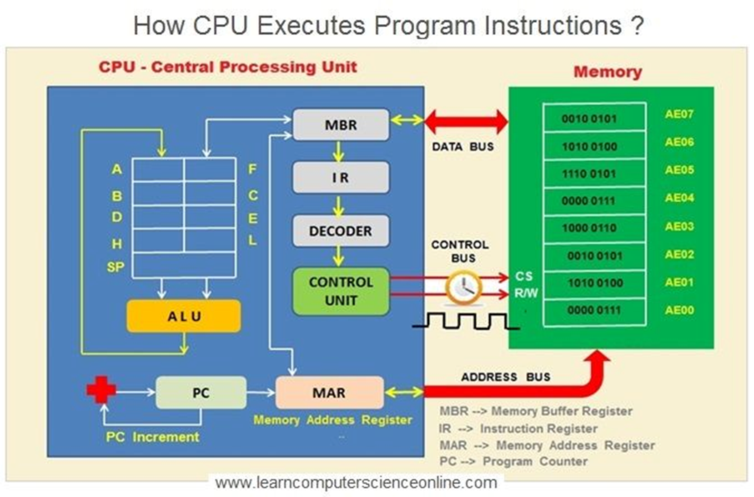
Embedded systems
CAIRO UNIVERSITY ECO-RACING TEAM
d. How a microprocessor works
1-Code Writing & Compilation
2-Code Upload to Flash Memory
3-Power-On & Reset Process
4-Fetch-Decode-Execute Cycle
5-Interrupt Handling (If Required)
6-Continuous Execution
MORE MILES TO ACHIEVE
WWW.CU-ECO.ORG

Slide 16
Embedded Systems
CAIRO UNIVERSITY ECO-RACING TEAM
Microcontroller Architecture
MORE MILES TO ACHIEVE
WWW.CU-ECO.ORG

Slide 17
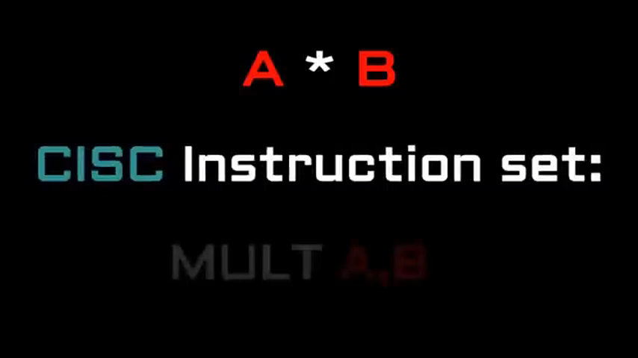
Microcontroller
CAIRO UNIVERSITY ECO-RACING TEAM
CISC vs RISC
MORE MILES TO ACHIEVE
WWW.CU-ECO.ORG

Slide 18
Microcontroller
CAIRO UNIVERSITY ECO-RACING TEAM
CISC vs RISC
CISC | RISC
Complex variable-length instructions | Simple fixed-length instructions
Smaller programs (fewer instructions needed) | Larger programs (more instructions needed)
Fewer general-purpose registers | More general-purpose registers
MORE MILES TO ACHIEVE
WWW.CU-ECO.ORG

Slide 19
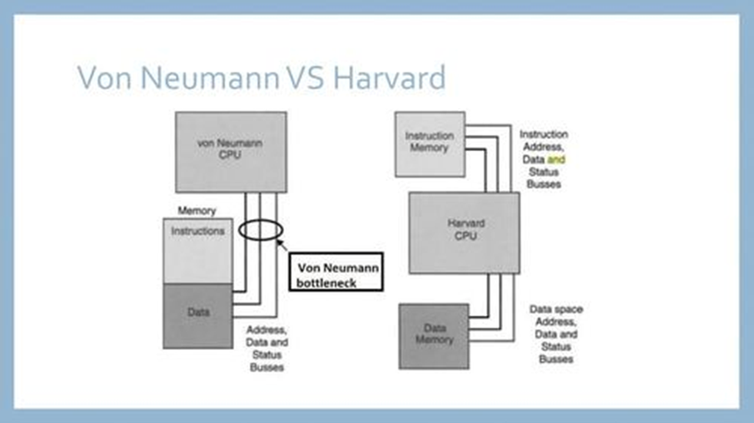
Microcontroller
CAIRO UNIVERSITY ECO-RACING TEAM
Von Neuman vs Harvard
MORE MILES TO ACHIEVE
WWW.CU-ECO.ORG

Slide 20
Microcontroller
CAIRO UNIVERSITY ECO-RACING TEAM
Von Neuman vs Harvard
Von Neuman | Harvard
Unified memory for program and data | Separate memory for program and data
Slower due to bus contention | Faster due to simultaneous access
Simpler hardware | More complex hardware
MORE MILES TO ACHIEVE
WWW.CU-ECO.ORG

Slide 21
Microcontroller
CAIRO UNIVERSITY ECO-RACING TEAM
RAM vs ROM
RAM | ROM
Temporary storage for variables,stack and data | Permanent storage for program code (firmware)
Volatile(data lost when power is off) | Non-volatile(data remained after power-off)
Stores runtime variables,stack and temporary data | Stores firmware , bootloader and constants
MORE MILES TO ACHIEVE
WWW.CU-ECO.ORG

Slide 22
Microcontroller
CAIRO UNIVERSITY ECO-RACING TEAM
SRAM vs DRAM
SRAM | DRAM
Transistors | Capacitors
Faster | Slower
Expensive | Cheap
Lower power | Higher Power
MORE MILES TO ACHIEVE
WWW.CU-ECO.ORG

Slide 23
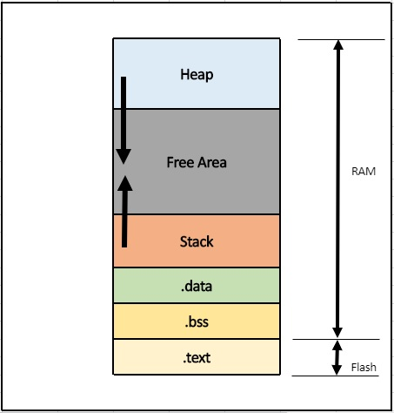
Microcontroller
CAIRO UNIVERSITY ECO-RACING TEAM
Memory Map
MORE MILES TO ACHIEVE
WWW.CU-ECO.ORG

Slide 24
ROM
CAIRO UNIVERSITY ECO-RACING TEAM
Masked ROM (MROM)
Description: Pre-programmed during manufacturing. Once data is written, it cannot be modified.
Advantages: Cost-effective for mass production.
Disadvantages: Cannot be updated; errors require a new chip
Use Cases: Embedded systems, gaming cartridges, microcontroller firmware
MORE MILES TO ACHIEVE
WWW.CU-ECO.ORG

Slide 25
ROM
CAIRO UNIVERSITY ECO-RACING TEAM
OTPROM (One-Time Programmable ROM)
Description: Programmable by the user only once using a special device
Advantages: More flexible than MROM; allows programming after manufacturing.
Disadvantages: Cannot be erased or reprogrammed.
Use Cases: Security keys, firmware storage in industrial applications.
MORE MILES TO ACHIEVE
WWW.CU-ECO.ORG

Slide 26
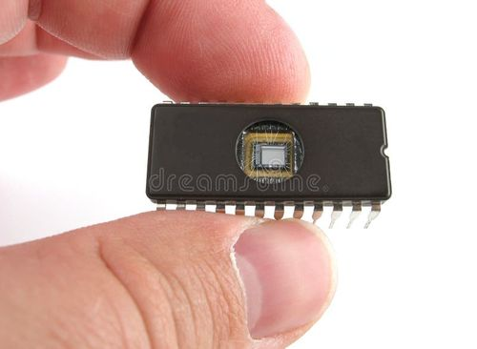
ROM
CAIRO UNIVERSITY ECO-RACING TEAM
EPROM (Erasable Programmable Read-Only Memory)
Description: Can be erased using UV light and reprogrammed multiple times.
Advantages: Allows updates and debugging.
Disadvantages: Requires UV exposure for erasure; slower than EEPROM.
Use Cases: Older BIOS chips, microcontrollers, and legacy embedded systems.
MORE MILES TO ACHIEVE
WWW.CU-ECO.ORG

Slide 27
ROM
CAIRO UNIVERSITY ECO-RACING TEAM
EEPROM (Electrically Erasable Programmable Read-Only Memory)
Description: Can be erased and reprogrammed using electrical signals.
Advantages: Byte-level erasing and rewriting, more flexible than EPROM.
Disadvantages: Slower write speeds, limited write cycles.
Use Cases: Microcontrollers (e.g., for storing configuration data), smart cards, RFID.
MORE MILES TO ACHIEVE
WWW.CU-ECO.ORG

Slide 28
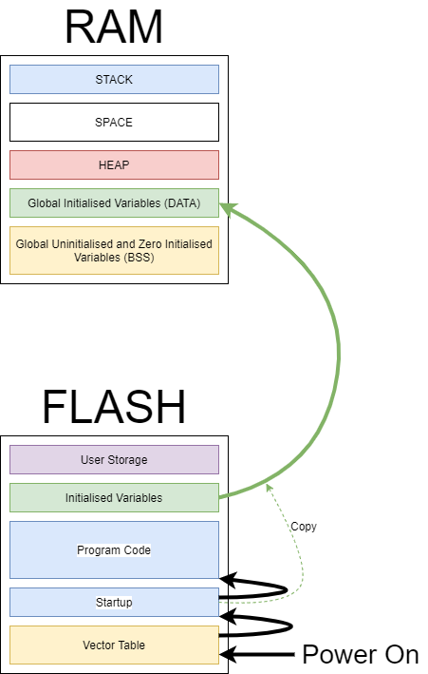
ROM
CAIRO UNIVERSITY ECO-RACING TEAM
Flash Memory
Description: An advanced form of EEPROM that erases and writes in blocks rather than bytes.
Advantages: Faster than EEPROM, high storage density, cost-effective.
Disadvantages: Limited write cycles (~10,000 to millions), block-level erasure.
Use Cases: USB drives, SSDs, microcontrollers, mobile phones.
MORE MILES TO ACHIEVE
WWW.CU-ECO.ORG

Slide 29
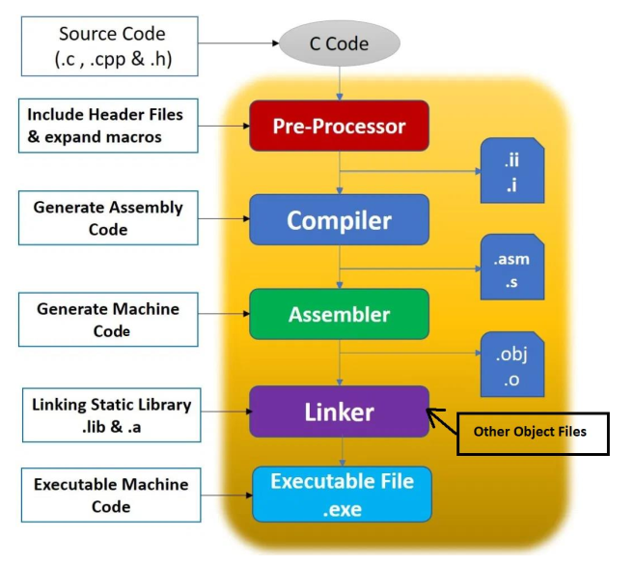
Toolchain
CAIRO UNIVERSITY ECO-RACING TEAM
A toolchain is a set of software tools used to convert source code into an executable binary for a microcontroller or processor.
MORE MILES TO ACHIEVE
WWW.CU-ECO.ORG

Slide 30
Toolchain
CAIRO UNIVERSITY ECO-RACING TEAM
1-Preprocessing (Preprocessor):
Handles preprocessor directives like #include, #define, and macros
2-Compilation (Compiler)
Converts preprocessed C code into Assembly code.
3. Assembly (Assembler)
Converts Assembly code into machine code (binary instructions).
4. Linking (Linker)
Combines multiple object files and libraries into a single executable.
MORE MILES TO ACHIEVE
WWW.CU-ECO.ORG

Slide 31
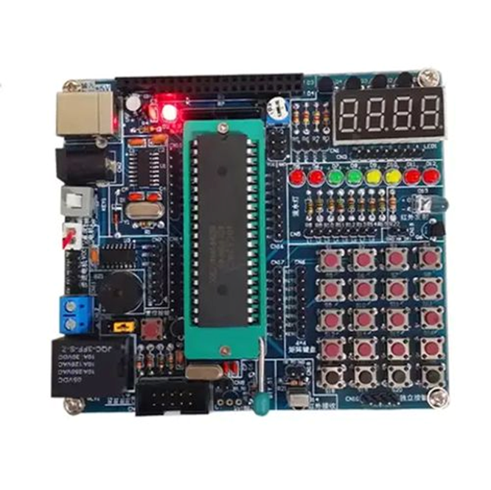
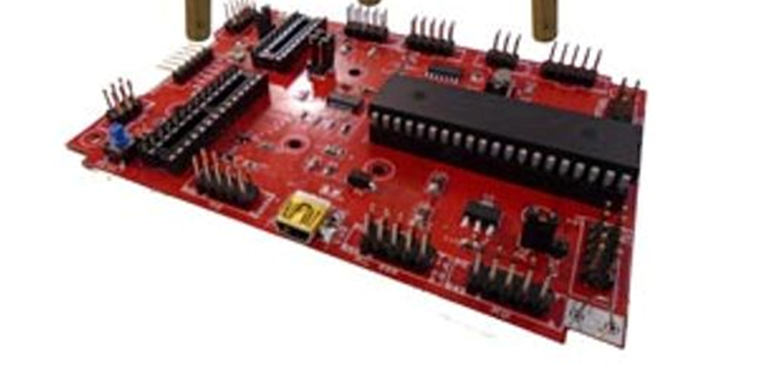
Toolchain
CAIRO UNIVERSITY ECO-RACING TEAM
5. Flashing
.
Off-Circuit Flashing:
Offline / External Programmer
On-Circuit Flashing :
In-System Programming - ISP / In-Circuit Serial Programming - ICSP
31
MORE MILES TO ACHIEVE
WWW.CU-ECO.ORG

Slide 32
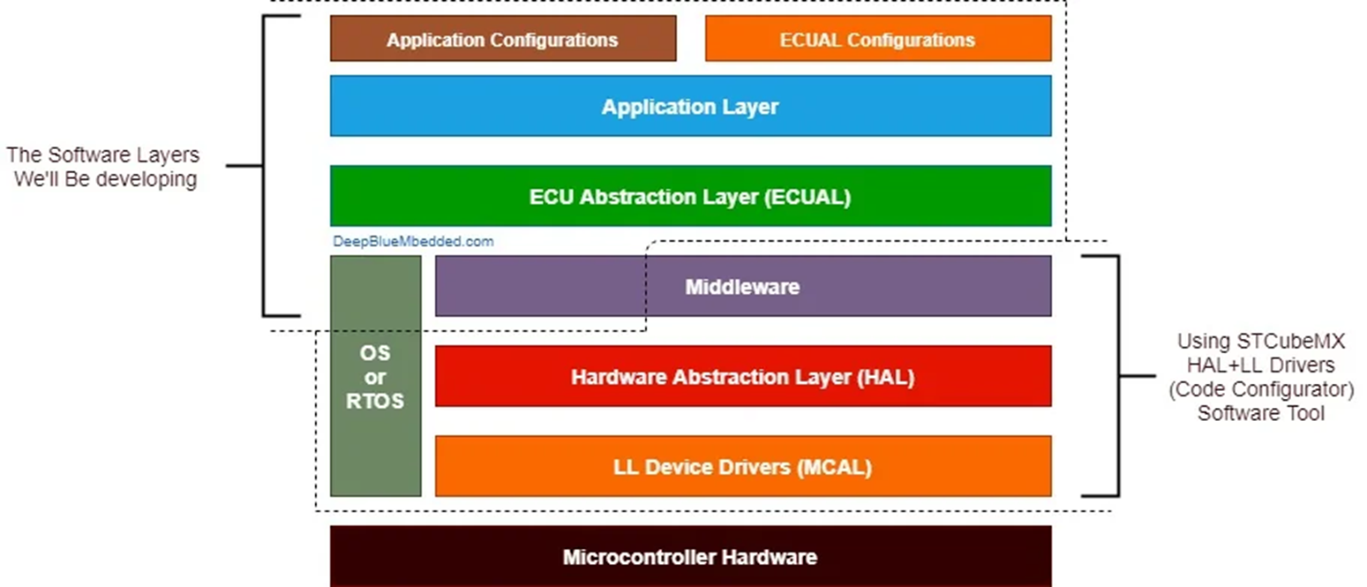
Software Architecture
CAIRO UNIVERSITY ECO-RACING TEAM
MORE MILES TO ACHIEVE
WWW.CU-ECO.ORG

Slide 33
Software Architecture
CAIRO UNIVERSITY ECO-RACING TEAM
1-Low-Level (LL)
Drivers Directly interacts with hardware registers
2-Hardware Abstraction Layer (HAL)
Provides an abstraction between the hardware and application.
3. Application Layer (APP)
The highest layer containing the main application logic.
4. Middleware / Libraries (LIB)
Contains the common libraries needed in most layers.
MORE MILES TO ACHIEVE
WWW.CU-ECO.ORG

Slide 34

Break
CAIRO UNIVERSITY ECO-RACING TEAM
57% passed
MORE MILES TO ACHIEVE
WWW.CU-ECO.ORG

Slide 35
Embedded Systems
CAIRO UNIVERSITY ECO-RACING TEAM
ARM Architecture
ARM Concepts
Intro to STM32 Cubes
MORE MILES TO ACHIEVE
WWW.CU-ECO.ORG

Slide 36
Embedded Systems
CAIRO UNIVERSITY ECO-RACING TEAM
ARM Concepts
MORE MILES TO ACHIEVE
WWW.CU-ECO.ORG

Slide 37

ARM
CAIRO UNIVERSITY ECO-RACING TEAM
ARM stands for "Advanced RISC Machine". It is a family of Reduced Instruction Set Computing (RISC) architectures widely used in embedded systems, mobile devices, and high-performance computing.
ARM processors are known for their power efficiency and scalability.
MORE MILES TO ACHIEVE
WWW.CU-ECO.ORG

Slide 38

ARM
CAIRO UNIVERSITY ECO-RACING TEAM
History of ARM
1-Acorn RISC Machine :
The first ARM processor, ARM1, was designed in 1985 with 25,000 transistors (compared to Intel’s 80386, which had 275,000 transistors).
2-Formation of ARM Ltd
In 1990, Acorn Computers, Apple, and VLSI Technology formed Advanced RISC Machines Ltd.
MORE MILES TO ACHIEVE
WWW.CU-ECO.ORG

Slide 39
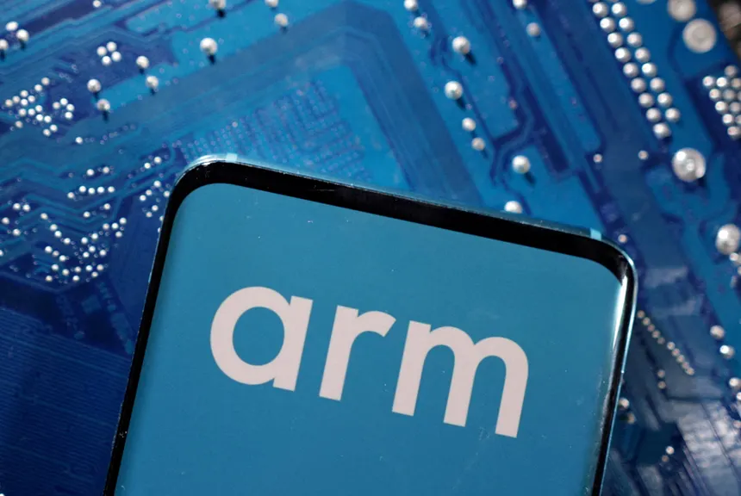
ARM
CAIRO UNIVERSITY ECO-RACING TEAM
History of ARM
3-Growth and Adoption :
ARM processors started appearing in mobile phones, PDAs, and embedded systems.
4-Smartphone Revolution :
Apple, Samsung, and Qualcomm started using ARM-based architectures.
5-Modern Era :
ARM is now used in automotive, data centers, AI applications, and even high-performance computing.
MORE MILES TO ACHIEVE
WWW.CU-ECO.ORG

Slide 40
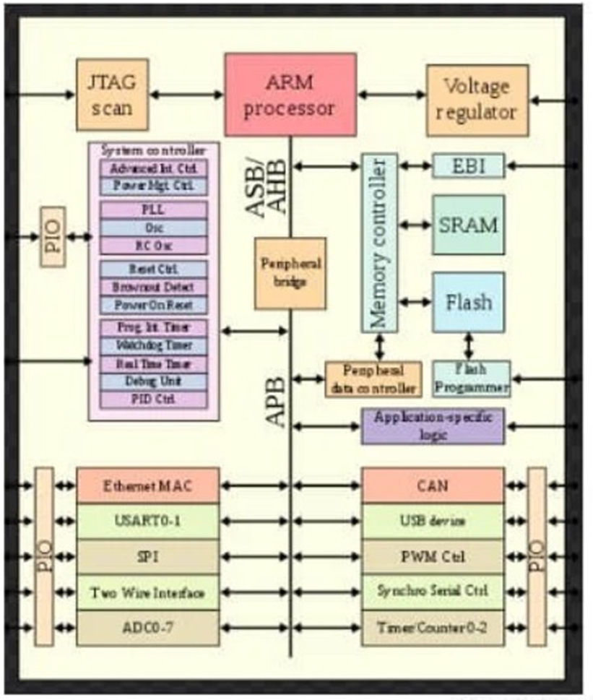
ARM
CAIRO UNIVERSITY ECO-RACING TEAM
ARM Architecture
MORE MILES TO ACHIEVE
WWW.CU-ECO.ORG

Slide 41
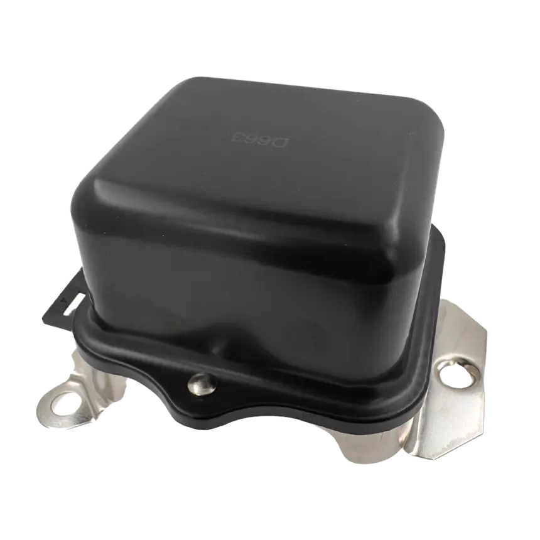
ARM
CAIRO UNIVERSITY ECO-RACING TEAM
ARM Architecture
1-Voltage Regulator
A voltage regulator ensures a stable power supply to different parts of an ARM-based system. It converts input voltage to the required levels for core logic, peripherals, and I/O.
2-Parallel I/O (PIO) and Communication Peripherals
Used to interface with GPIO (General-Purpose I/O) pins that can be configured as input/output.
MORE MILES TO ACHIEVE
WWW.CU-ECO.ORG

Slide 42
ARM
CAIRO UNIVERSITY ECO-RACING TEAM
ARM Architecture
3-AMBA
AMBA (Advanced Microcontroller Bus Architecture) is a protocol developed by ARM to standardize the communication between different components of an ARM-based system. It is widely used in microcontrollers, SoCs (System-on-Chips), and embedded systems to manage high-speed data transfer and peripheral control.
MORE MILES TO ACHIEVE
WWW.CU-ECO.ORG

Slide 43
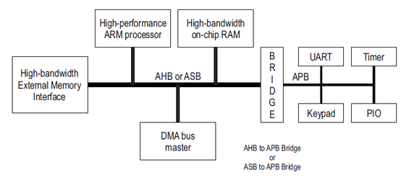
ARM
CAIRO UNIVERSITY ECO-RACING TEAM
ARM Architecture
3-AMBA
Peripheral bridge: Since AHB and APB operate at different speeds, a peripheral bridge is used to connect AHB (fast bus) to APB (slow bus).
MORE MILES TO ACHIEVE
WWW.CU-ECO.ORG

Slide 44
ARM
CAIRO UNIVERSITY ECO-RACING TEAM
ARM Architecture
3-AMBA
AHB | APB
Fast | Slow
Complex | Simple
MORE MILES TO ACHIEVE
WWW.CU-ECO.ORG

Slide 45
ARM
CAIRO UNIVERSITY ECO-RACING TEAM
ARM Architecture
4-Power management
Power management in ARM-based microcontrollers involves controlling clocks and power to various peripherals and system components.
RCC:
is a global controller for system clocks and resets.
Enable:
are specific to peripherals, allowing fine-grained power control.
MORE MILES TO ACHIEVE
WWW.CU-ECO.ORG

Slide 46
Embedded Systems
CAIRO UNIVERSITY ECO-RACING TEAM
STM32 Cube IDE
MORE MILES TO ACHIEVE
WWW.CU-ECO.ORG

Slide 47
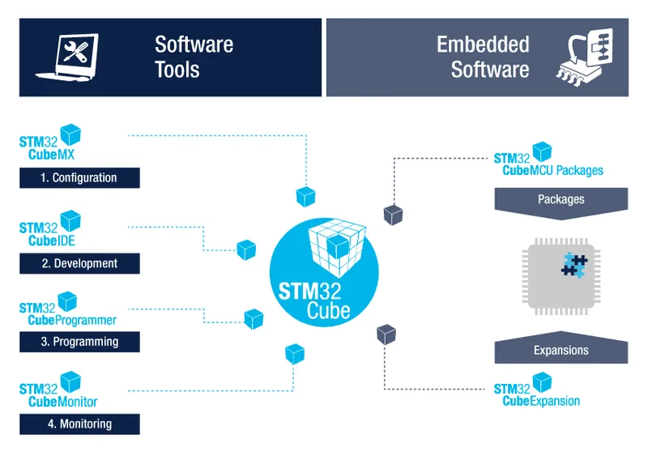
STM32
CAIRO UNIVERSITY ECO-RACING TEAM
STM32 Cube IDE
Why STM32 ?
STM32 is widely used in the industry as MCUs are based on the ARM Cortex-M series (M0, M3, M4, M7, etc.), providing scalability, efficient processing, and strong ecosystem support.
Strong Community & Open-Source Support as a Large developer and open-source communities provide ample resources, libraries, and third-party tools for STM32 development.
MORE MILES TO ACHIEVE
WWW.CU-ECO.ORG

Slide 48
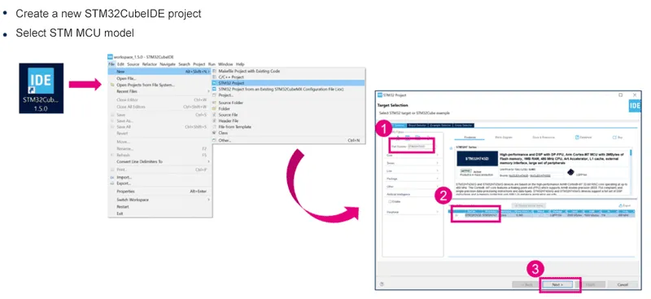
STM32
CAIRO UNIVERSITY ECO-RACING TEAM
Create STM32 Project
MORE MILES TO ACHIEVE
WWW.CU-ECO.ORG

Slide 49
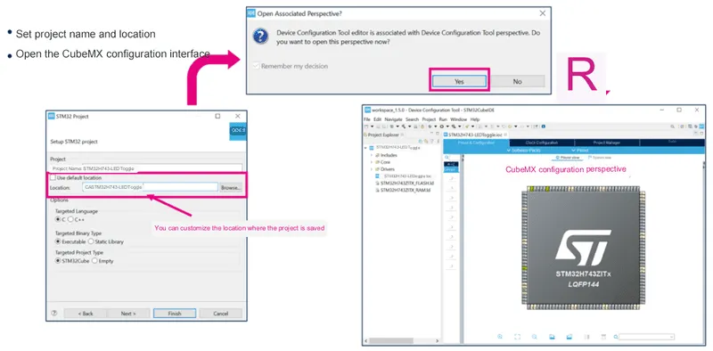
STM32
CAIRO UNIVERSITY ECO-RACING TEAM
Configuration Perspective
MORE MILES TO ACHIEVE
WWW.CU-ECO.ORG

Slide 50
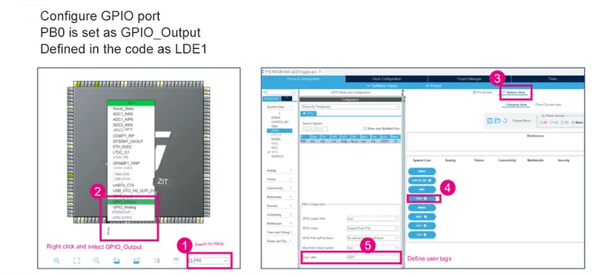
STM32
CAIRO UNIVERSITY ECO-RACING TEAM
Configure GPIO
MORE MILES TO ACHIEVE
WWW.CU-ECO.ORG

Slide 51
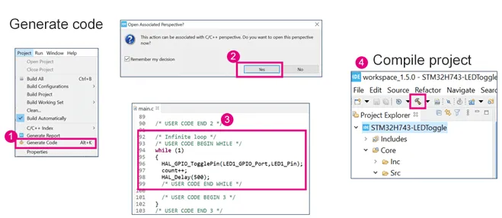
STM32
CAIRO UNIVERSITY ECO-RACING TEAM
Generate Code
MORE MILES TO ACHIEVE
WWW.CU-ECO.ORG

Slide 52
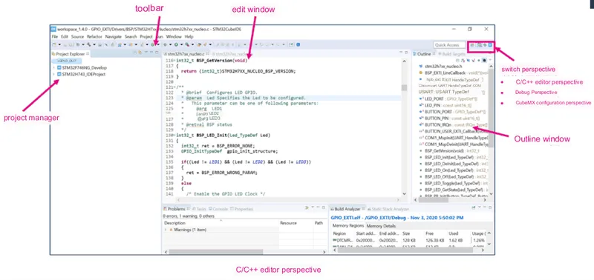
STM32
CAIRO UNIVERSITY ECO-RACING TEAM
Code Perspective
MORE MILES TO ACHIEVE
WWW.CU-ECO.ORG

Slide 53
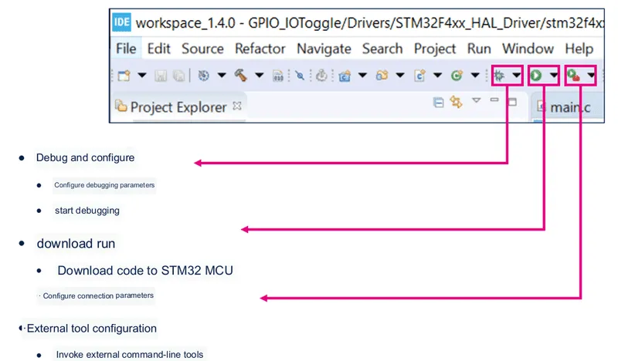
STM32
CAIRO UNIVERSITY ECO-RACING TEAM
Code Debugging
MORE MILES TO ACHIEVE
WWW.CU-ECO.ORG

Slide 54
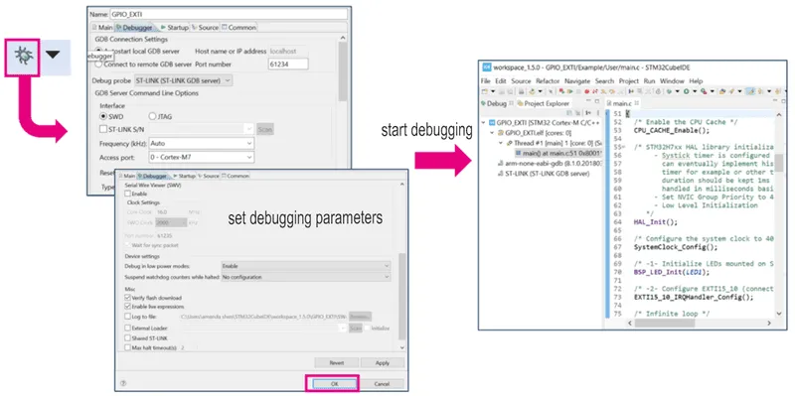
STM32
CAIRO UNIVERSITY ECO-RACING TEAM
Start Debugging
MORE MILES TO ACHIEVE
WWW.CU-ECO.ORG

Slide 55

Thank You
MORE MILES TO ACHIEVE
WWW.CU-ECO.ORG

Slide 56
Refrences
STM32 Tutorial:
https://reversepcb.com/stm32cubeide/
Whole learning phase:
https://www.youtube.com/playlist?list=PLoiqjtgvXf9e2VJk8GWEXwECPM_7JRwkE
MORE MILES TO ACHIEVE
WWW.CU-ECO.ORG

